Slide 1
IBM Hack CHallenge
Problem Statement 2
Team - CaptainMarvel

Slide 2
Team Members
Sunita Sen
Role:
Development of the Node.js application
Development of the backend of the web app.
Deployment of the app in cloud.

Slide 3
Technology Stack
Programming Languages : NodeJS with Express Framework, Python
b) Hosting Servers : Heroku
c) Server Type : REST
d) Machine Learning Models Used :
e) Third Party APIs : stackexchange api(unregistered)

Slide 4
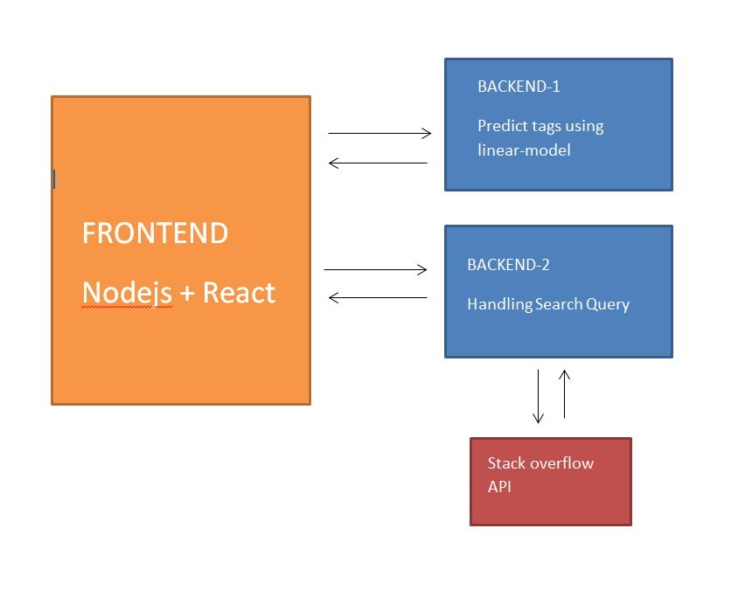
Architechture

Slide 5
Process Flow
User provides the search query
The frontend of the application makes call to the backend flask api endpoint
The flask api makes request to the stackexchange api with the modified search query and returns top questions,answers and linked questions
At the same time the frontend makes request to the backend flask api for tag predictions
The backend then predicts the tags and returns the predicted tags
Finally, predicted tags, questions, answers and linked questions are populated on the web app.

Slide 6
Model
Processes query received to predict tags
Query
Frontend
Receives Query
Tags
Query
Backend
Processes query to send it to SO api
Questions
Answers
Link. Questions
Items
ProcessedQuery
Stackexchange API

Slide 7
Framework USED for UI/UX
Node.js – Express
React.js
Tachyons node module – for styling
Bootstrap – for styling
React Load Spinner for loading symbol

Slide 8
References:
API: https://api.stackexchange.com/docs/
Coursera NLP course assignment: https://www.coursera.org/learn/language-processing

Slide 9
Thank You

